Slide 1

RUNGTA COLLEGE OF DENTAL SCIENCES & RESEARCH
TITLE OF THE TOPIC:
DEPARTMENT OF CONSERVATIVE DENTISTRY AND ENDODONTICS

Slide 2
Specific learning Objectives
At the end of this presentation the learner is expected to know ;
Core areas* | Domain ** | Category #
ANATOMY OF PERIAPEX CEMENTUM PERIODOTAL LIGAMENT INGLES CLASSIFICATION ZONES OF FISH | COGNITIVE | MUST KNOW
PATHWAY OF ENTRY OF MICROORGANISMS IN TOOTH | PSYCHOMOTOR | NICE TO KNOW
DIAGNOSIS OF PERIAPICAL TISSUE ENDO PERIO LESSIONS | AFFECTIVE | DESIRE TO KNOW

Slide 3
CONTENTS
INSTRUMENT GRASP
MODIFIED PEN GRASP
STANDARD PEN GRASP
PALM AND THUMB GRASP
FINGER REST
CONVENTIONAL
CROSS ARCH
OPPOSITE ARCH
FINGER ON FINGER

Slide 4
INSTRUMENT GRASP
These are the manner of holding the instruments
There are four grasps used with the hand instruments:
Modified pen
Inverted pen
Palm and thumb
Modified palm and thumb

Slide 5
FINGER REST :
CONVENTIONAL
CROSS ARCH
OPPOSITE ARCH
FINGER ON FINGER

Slide 6
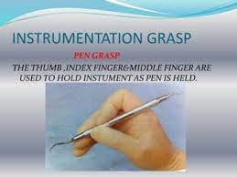
PEN GRASP
THE THUMB, INDEX FINGER & MIDDLE FINGER ARE USED TO HOLD INSTRUMENT AS PEN IS HELD

Slide 7
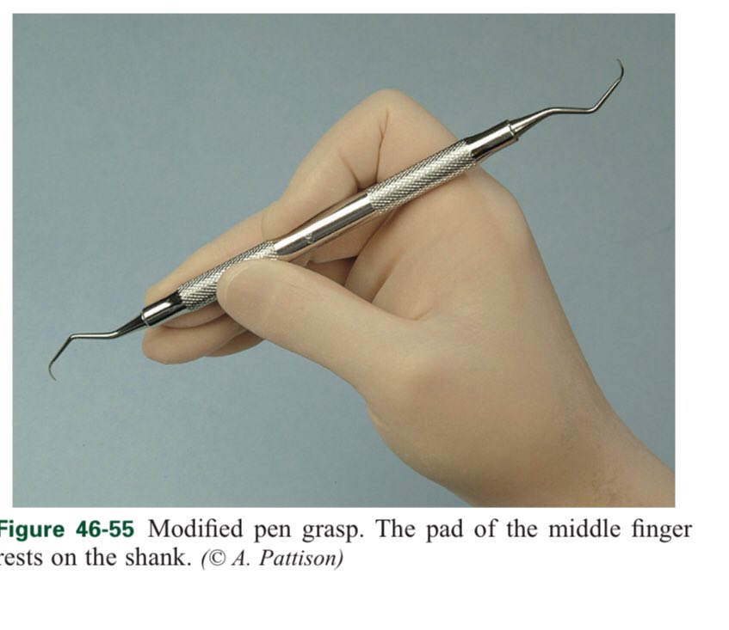
MODIFIED PEN GRASP
THE MOST EFFECTIVE& STABLE GRASP THE PAD OF MIDDLE FINGER REST ON THE SHANK

Slide 8
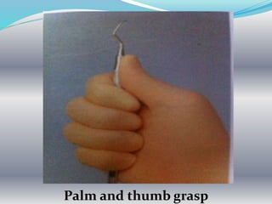
PALM AND THUMB GRASP
USEFUL FOR STABILISING INSTRUMENTS DURING SHARPENING & FOR MANIPULATING AIR & WATER SYRINGE
NOT RECOMMENDED FOR PERIODONTAL INSTRUMENTATION

Slide 9
FINGER REST
SERVES TO STABILIZE THE HAND & THE INSTRUMENT BY PROVIDING A FIRM FULCRUM AS A MOVEMENTS
A GOOD FINGER REST PREVENT INJURY
MAXIMAL CONTROL IS ACHIEVED BY USING MIDDLE FINGER
MIDDLE FINGER IS KEPT BETWEEN THE INSTRUMENT SHANK AND FOURTH FINGER

Slide 10
FINGER REST
INTRAORAL FINGER REST EXTRA ORAL FULCRUMS
CONVENTIONAL 1. PALM UP
CROSS ARCH 2. PALM DOWN
OPPOSITE ARCH
FINGER ON FINGER

Slide 11
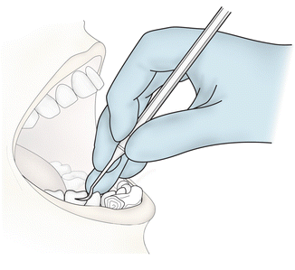
INTRA ORAL FINGER REST
ITS ON TOOTH SURFACE CLOSE TO THE WORKING AREA
CONVENTIONAL : THE FINGER REST IS ESTLABLISHED ON TOOTH SURFACES IMMEDIATELY ADJACENT TO THE WORKING AREA

Slide 12
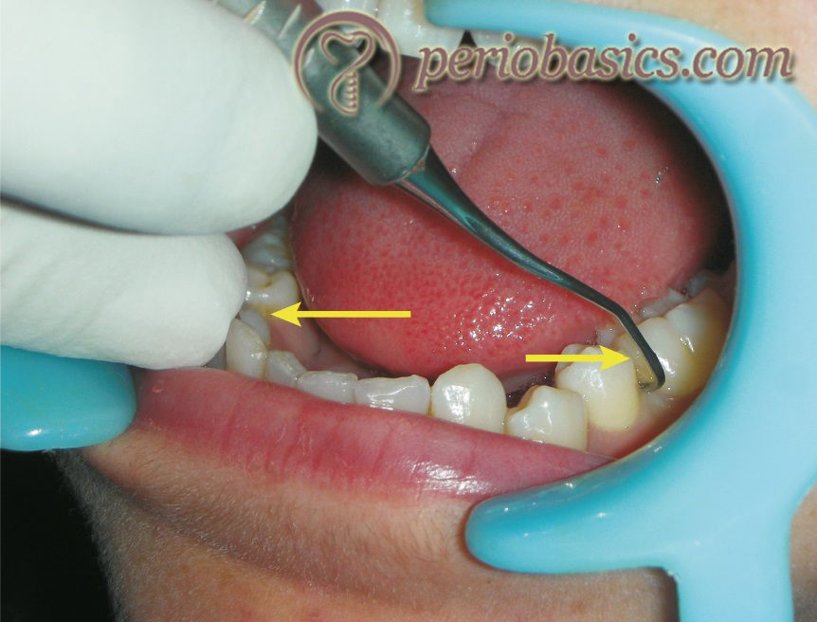
CROSS ARCH : THE FINGER REST IS ESTLABLISHED ON TOOTH SURFACES ON THE OTHER SIDE OF THE SAME ARCH

Slide 13
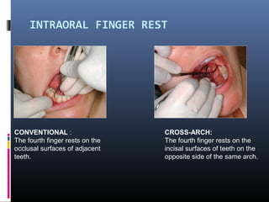

Slide 14
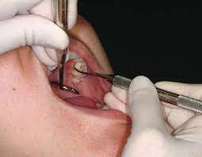
OPPOSITE ARCH : THE FINGER REST IS ESTLABLISHED ON TOOTH SURFACE ON THE OPPOSITE ARCH

Slide 15
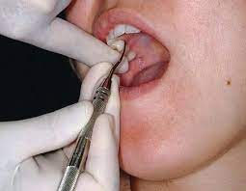
FINGER ON FINGER : THE FINGER REST IS ESTLABLISHED ON THE INDEX FINGER OR THUMB OF THE NON OPERATING HAND

Slide 16
EXTRA ORAL FULCRUMS
EFFECTIVE FOR POSTERIOR MAXILLARY TOOTH
ALLOW OPTIMAL ACCESS & ANGULATION WHILE PROVIDING ADEQUATE STABILIZATION
FINGERS IS PLACED ON THE PATEINTS FACE TO PROVIDE GREATEST DEGREE OF STABILITY

Slide 17
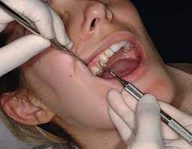
2 TYPES
1) PALM UP : THE PALM FULCRUM IS ESTLABLISHED BY RESTING THE BACKS OF THE MIDDLE FINGER & FOURTH FINGER ON THE SKIN OVERLYING THE LATERAL ASPECT OF MANDIBLE ON THE RIGHT SIDE OF THE FACE

Slide 18
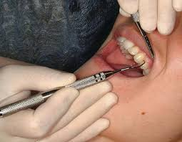
PALM DOWN : THE PALM DOWN FULCRUM IS ESTLABLISHED BY RESTING THE FRONT SURFACES OF THE MIDDLE & FOURTH FINGER ON SKIN OVERLYING THE LATERAL ASPECT OF THE MANDIBLE ON THE LEFT SIDE OF FACE

Slide 19
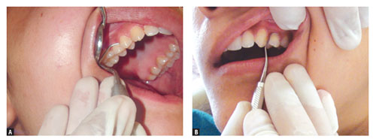
PALM UP AND PALM DOWN

Slide 20
INSTRUMENT ADAPTATION
ADAPTATION :
ADAPTATION REFERS TO THE MANNER IN WHICH THE WORKING END OF PERIODONATL INSTRUMENT IS PLACED AGAINST THE SURFACE OF TOOTH.
OBJECTIVE IS TO MAKE THE WORKING END OF INSTRUMENT CONFORM THE CONTOUR OF THE TOOTH SURFACE

Slide 21
ANGULATION :
IT REFERS TO THE ANGLE BETWEEN FACE OF A BLADED INSTRUMENT AND THE TOOTH SURFACE
ALSO CALLED TOOTH- BLADE RELATIONSHIP
DURING INSERTION ANGLE IS 0 DEGREE
SCALING AND ROOT PALNING 45 TO 90 DEGREE

Slide 22
Take home message
Dentistry a modified pen grasp is used.
The middle finger is modified and the side of the finger placed on the shank of the instrument.
The index finger is bent at the second joint and is positioned above the middle modified pen grasp finger on the same side of the handle.

Slide 23
Questions :
Write a note on instrument grasp ?
Write a note on finger rest ?
Describe palm and thumb grasp.

Slide 24
REFERENCES
Jill Shiffer Nield-Gehrig, Fundamentals of periodontal instrumentation & advanced root instrumentation, 6th edition
2. Carranza's Clinical Periodontology, 9th edition
3. H. Dong, et al, The effects of finger rest positions on hand muscle load and pinch force in simulated dental hygiene work; Journal of Dental Education, Apr 2005
4. Gordon L. Pattison et al, Periodontal Instrumentation
5. Anna M. Pattison, Dimensions of Dental Hygiene, Oct 20046. Diane Millar, Reinforced Periodontal Instrumentation and Ergonomics for Dental Care Provider, Apr 2007

Slide 25
THANK YOU

